Slide 1
Liberation psychology
Broderick Sawyer, PhD

Slide 2
BIO
Independent
Louisville KY
Clinical PhD from U. of Louisville
Trigger warning- I am here to bend your mind, eat food fully before resisting

Slide 3
collective narrative
Liberation starts with truth telling
It ends with accountability

Slide 4
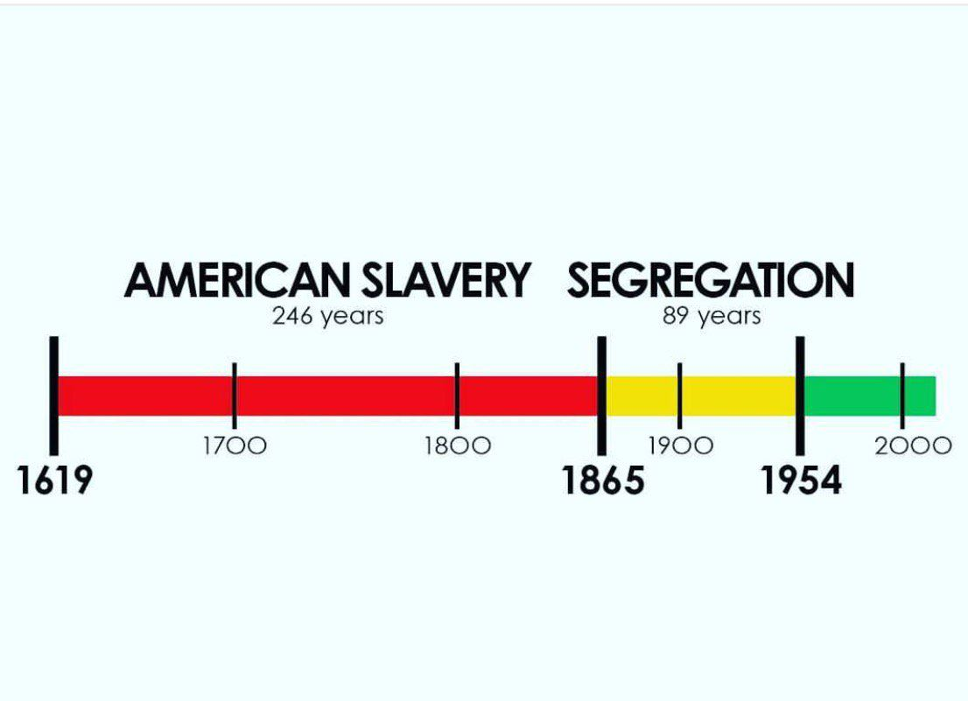
Timeline

Slide 5
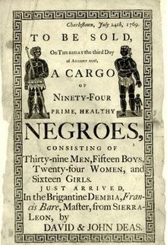
Ownership
“Sawyer”
“Mine”
Belonging to
Do what I want, be where I want.

Slide 6
Traumas Endured: 2.5 centuries
Literally kidnapped from home, forced to work for free, families separated on a business whim.
Beaten, starved, lynched, killed, forced into labor from birth through death- 246 years.
Wives, daughters, etc. taken from living quarters, raped, and returned.

Slide 7
Rationalization: “its okay because..”
Sub-human
Criminals
Lazy
Stupid
Rapists
Birth of a nation, 1915. America’s first feature-length motion picture.
Originally called “The Clansmen”
Popularized the KKK, made them look like heroes.

Slide 8
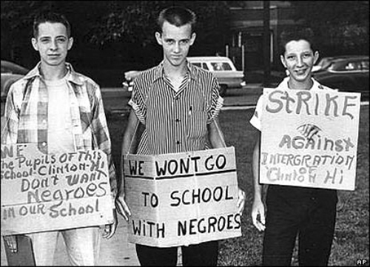
integration
Integration an awkward proposition for both, or the perfect solution?
Live with ‘animals’, live with oppressors
If separate was equal, would integration have come up?

Slide 9
Fish in water
Superior/inferior “roles” enacted
Conditioning from all of this so strong, we don’t know the extent unless we actively review historical & current contexts.
News, TV shows, magazines, etc., all latent with stereotypes
White heroes, White damsels in distress
Choosing roles for BP, thugs, prostitutes, etc. : “Hmm you play this role. It just feels right.”
People watch and see stereotypes as “normal” ways to think

Slide 10
Fish in water
American systems economically decimate Black communities = stress, trauma, violence.
Punish Black communities for the stress, trauma, and violence that White systems have caused.
Mass incarceration: Government contracts with private prison companies, the say, you must have X number of people in prisons according to the contract (aka- arrest, charge, and imprison X amount of people)
“Justice” is based on business quotas
Problem trying to blend truth when financial interests are involved.

Slide 11
Collective trauma
BIPOC- racial trauma isn’t a disorder, its a daily reality.
Can require therapy if symptoms severe enough.
Anxiety, depression, panic attacks, PTSD, etc.
Systems are problematic, not people
Keep your emotional self small- Slavery example
Whites- have social power to avoid the truth of privilege
Avoidance, defensiveness, anger, shame/guilt
Systems responsible for your conditioning, not you.
PTSD veteran comparison
Taught/reinforced to believe emotional needs are bigger, more important than others
Systems prioritize your feelings, because systems are run by other Whites
Heart is shut down to the suffering of BIPOC- Nervous system theory
Different responses, but both racial trauma, both require healing.

Slide 12
The field
“This is empirically based”
Who is more likely to get the degrees?
Who asks the research questions? Are indigenous narratives of healing included?
1 on 1 treatment, rather than healing in community
Use of IQ tests
Defining what is “normal” based on pathological cultural norms.
How do we remove our bias as to what is “normal” versus not?

Slide 13
Liberation psychology
Open space, evenly suspended attention.
Fostering inner growth by providing space to fully experience
Intervention used to supplement, not drive treatment.
Hammer meet nail, not just hammering everything.
Cultural norms will cause you to see anger as “pathological”, or African passion as “bipolar spectrum affect”.
Psychosis often misdiagnosed in African Americans because of hyperspirituality
There is no prescription or framework of healing to keep in mind, this being is complete and we are helping them find the courage to be themselves, as they are.
What is adaptive to them, is not adaptive to dominant society

Slide 14
Environmental focus
Humans are regenerative
Empowerment
Confidence in own reactions/emotions
Can’t get validation from systems that invalidate you
Ancestral memory
What African Americans are missing from Africa is their memory, and what they are missing from America is the fact that they are not American
Community healing
Heal the environment to heal the individual
Maslow’s hierarchy, Black Panther Party
Love and connection

Slide 15
Environmental focus
Decolonizing value systems
Limit colonizing species/ideas
Internalized oppressive values
You carry oppressive values around with you
The fish doesn’t know what water is
Working with activists versus Black MH professionals
Credentials
Liberated thought processes
Afro-futurism

Slide 16
Therapeutic integration
Relationship
Pace and space
The power of authentic narrative
Black male and anger suppression/expression
Systemic rupture of being White- trained
Strong countertransference to control

Slide 17
DBT and racial trauma
Radical Acceptance of inner experiences
Acceptance does not mean approval: Math metaphor
Dialectic
Action and acceptance, being and doing at the same time
Social justice

Slide 18
Emotion-focused work
Normalize emotional experience
Mindfulness and sublimation: Focusing emotional energy
Anger
Joy
Grief
Fear
Blockages and learning
What emotions allowed in front of my therapist vs not?
What emotions safe to experience versus not?
Healthy avoidance- White people taught most emotions okay. For BIPOC folks, not as okay to experience ANYTHING.

Slide 19
Anxious/traumatic sx
No thought challenging
Right/wrong comes from supremacist ideals
Longitudinal conceptualization
Learning theory, conceptualization of narrative to understand personal perception, not what you think
Strength-based skill building
You are not expert in their culture
Feeling based; what feels good, not what intervention is supported, not what “should work” for them even if they say it. Dealing with what is
Daily coping regimen
Daily collection of activities; great for college students
Mindfulness and values
Energy audit

Slide 20
depression
Value-based behavioral activation
Normalizing sadness: Washcloth metaphor
The art of rest
Reparations
Political/community action as healing
Another form of BA
Feel like they are actually solving the problem

Slide 21
Compassion-focused
Self-compassion
Community compassion
Compassion exercises

Slide 22
resources
Toward Psychologies of Liberation
Mary Watkins and Helene Shulman
Writings for a liberation psychology- Martin Baro

